Slide 1

Excel Reassessment

Slide 2
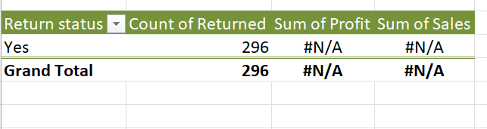
Case Study 1
Insights:
Create a pivot table for orders where
Return status is yes
Inference:
296 orders were returned

Slide 3
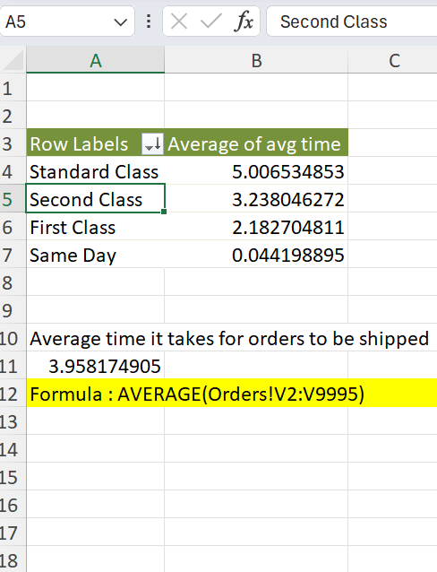
Case Study 2
Insights: Formula
AVERAGE(Orders!V2:V9995)
Inference:
- Average time it takes for orders
To be shipped is 3.958 days
- Shipment mode with fastest
delivery time is “Same day” and
slowest delivery time is “Standard class”

Slide 4
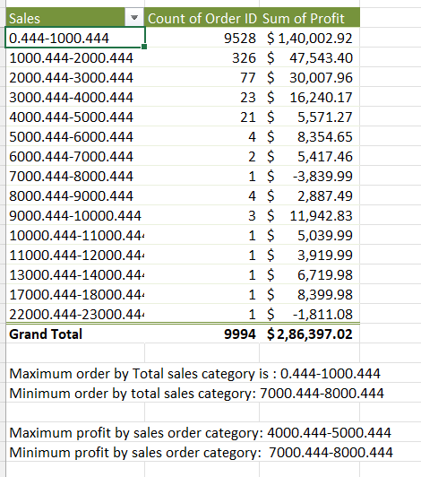
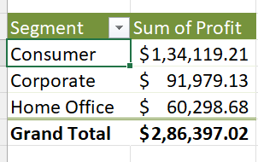
Case Study 3
Inference:
Maximum order by Total sales category is :
0.444-1000.444
Minimum order by total sales category:
7000.444-8000.444
Maximum profit by sales order category:
4000.444-5000.444
Minimum profit by sales order category:
7000.444-8000.444
Most profitable Customer segment is Consumer
Insights:
Using pivot table, group sales and find count of orderID and profit sum

Slide 5
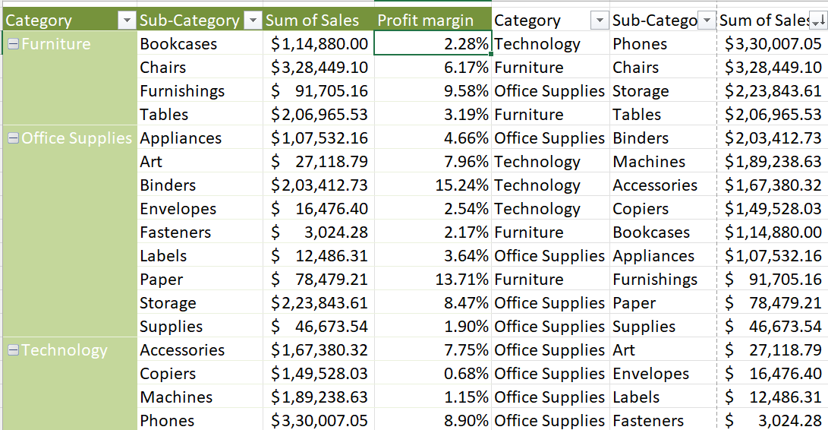
Case Study 4
Top selling product category and subcategory
Category: Technology and subcategory phones are top selling
Insights:
Create a pivot table with category and subcategory, find sum of sales and profit margin as percentage in values.

Slide 6
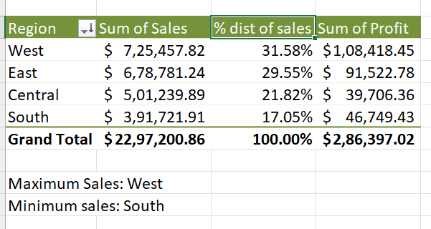
Case Study 5
Inference:
- Region with highest sales: West
- Region with lowest sales: South

Slide 7
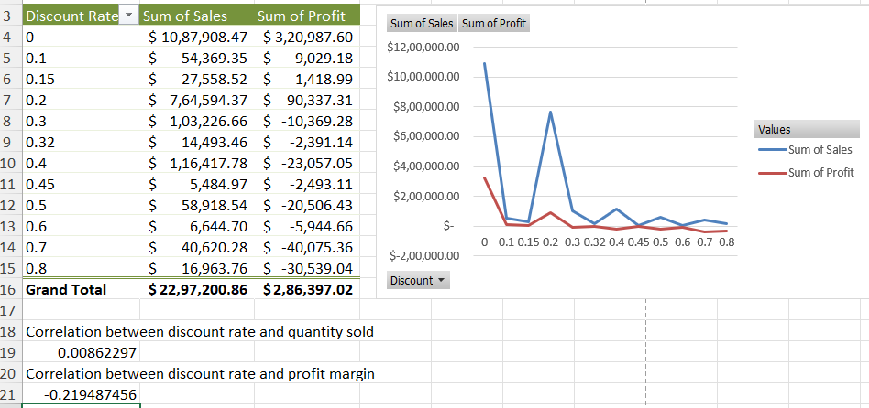
Case Study 6
Inference:
As the discount increases, the profitablilty reduces. In case of discount rate 0.3 and above, it leads to losses instead of profit.
Correlation between discount rate and quantity sold: 0.00862
Correlation between discount rate and profit margin: -0.2194
Insights:
By creating a line chart from pivot table, we can come to the conclusion that as the discount rate increases,
profits decreases.

Slide 8
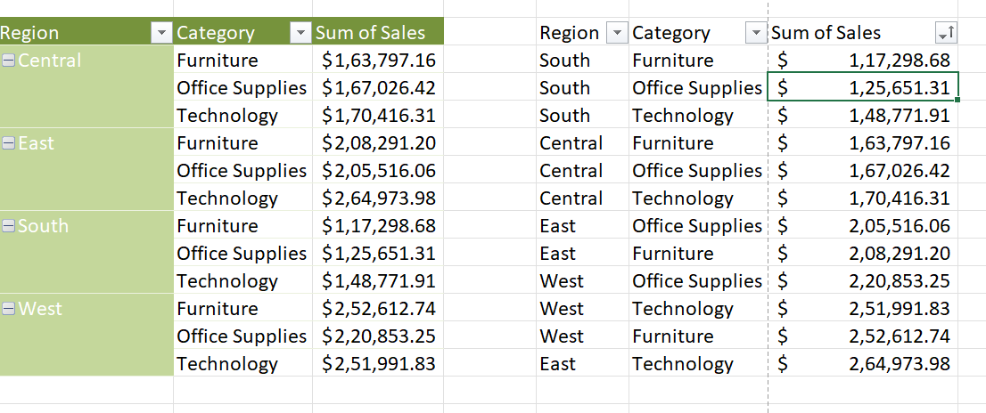
Case Study 7
Inference:
The South region has high potential for expansion because although it has lowest sales,
it is a positive value
Which means it is
Not running in loss
Insight:
Create a pivot
Table using region
For every category
And sales

Slide 9
Case Study 8

Slide 10
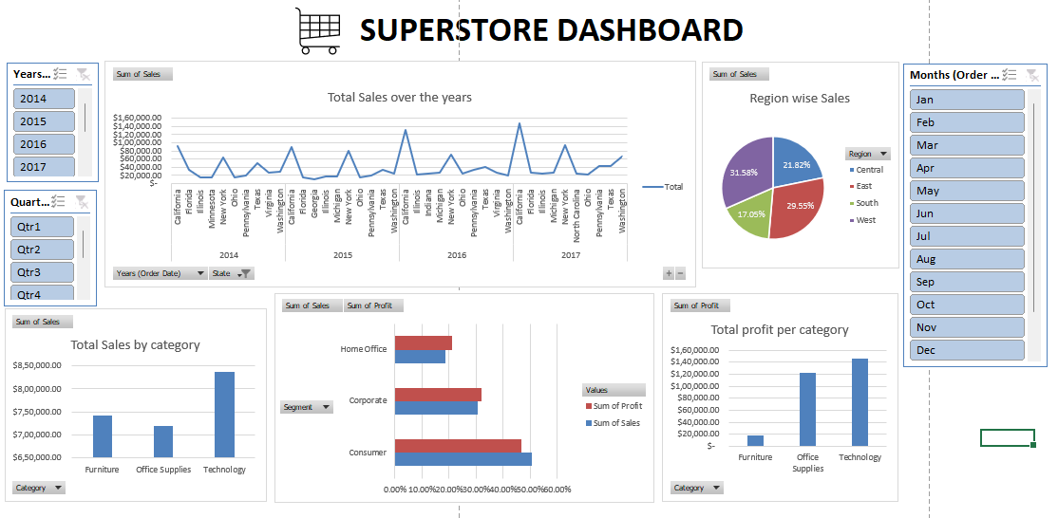
Dashboard

